Slide 1
The Role of Context in Memory Storage and Retrieval
Lea Lai, Indiana University
Richard Shiffrin, Indiana University
ASIC 2024

Slide 2
Context plays a fundamental role in theories of memory storage and retrieval.
What is context? How is it different than content?

Slide 3
Content:
When an event is stored in memory some of the information is called ‘content’ and refers to information that distinguishes this event from other similar events that may have occurred in the same setting. Thus during study of a list of words one might encounter “TABLE” and store the visual form, the spelling and the meaning of this word. This content information distinguishes this work from another word studied on the same list, “BOOK”.
Both were studied in the same ‘context’.

Slide 4
Context:
An event stored in memory also includes information about the context in which the event occurs. Thus during study of TABLE the memory stored can include information about the room in which the list was presented, the equipment, the weather, one’s mood, one’s bodily feelings and reactions, any sounds at the time, any other people nearby, and much more along these lines.

Slide 5
Context is critical to enable one to focus retrieval upon events of interest (event storage and retrieval is also called episodic memory).
E.g. if you are asked to recognize whether the word TABLE had been on the list just presented, it is context that will enable you to focus retrieval on the recent occurrence of TABLE rather than the millions of other lifetime events containing that word.
Context is generally assumed to change as time passes and other events intervene (e.g. Mensink & Raaijmakers, 1988).

Slide 6
A few things we know about context from laboratory experiments:
It changes little during study of a list of items, but changes between list study and test. Also likely changes as testing continues: I.e. Testing changes context more than study.
Context is usually stored automatically for a second or two and additional study time is spent on storing content (like meaning): (Malmberg & Shiffrin, 2005).
Context may be stored in a way that integrates it with content, or separately from content (Murnane, Phelps & Malmberg 1999).

Slide 7
In most memory studies memory retrieval is probed with current context at the time of test. This focuses retrieval on recent events.
If one desires to retrieve events in the past, can this be facilitated by reconstructing the context at the time of storage? There is not much research, but Bauml and colleagues have recently published such evidence (e.g. Bauml & Trissl, 2022).

Slide 8
Context is seldom varied in memory experiments.
Occasionally attempts are made to do so, for example by changing the room in which events are studied to a different room for testing.
These attempts generally produce very small effects, probably because the aspect of context manipulated is just one of hundreds of elements that make up context.
Models of context are very primitive, generally assuming little more than the fact that context changes over time and in different settings.

Slide 9
The present study was therefore designed to shed light on context and hopefully lead to a detailed model of its role in memory (a model instantiated in the REM framework, given how well REM works).
Participants in Study 1 were tested with recognition for pictures.
Participants in one Study 2 were tested with cued recall for words.
The designs were similar, and accuracy and response time were measured. Today’s talk will focus only on accuracy results in recognition of pictures.

Slide 10
Participants studied a list of 20 pictures and were then tested for OLD/NEW recognition of ten of the studied pictures (‘Targets’) and ten new pictures (‘Foils’).
They studied and were tested on ten such lists in succession, knowing that targets were only from the list just studied, and foils were always totally new.

Slide 11
There was then a brief break for instructions and there was a final recognition test.
In this test, every picture encountered in the first part of the session (termed Initial) was now a target and required an OLD response. These final targets were all items studied initially but not tested (ten per list), all targets tested initially (ten per list), and all foils tested initially (ten per list). These 300 final targets were mixed with 300 totally new foils, requiring a NEW response.

Slide 12
There were three groups that differed in the way that final testing was carried out:
The ‘Random’ group had all final targets and foils randomly mixed.
The ‘Forward’ group started final testing with targets from the first list studied: ten pictures studied and not tested, ten pictures studied and tested, and ten foils, 30 final targets mixed with 30 new foils. Then the next initial list, and so on until all pictures were tested.
The ‘Backward’ group started final testing with targets from the last list studied: ten pictures studied and not tested, ten pictures studied and tested, and ten foils, 30 final targets mixed with 30 new foils. Then the next to last initial list, and so on until all pictures were tested.

Slide 13
The participants were recruited on the web from Prolific.
The Forward and Backward groups were informed about the order of final testing: Before each of the groups of 60 tests they were told which initial list the new targets were coming from.
These Forward and Backward groups were designed to assess the possibility that knowledge of what earlier list was being tested would enable the probe of memory to use context appropriate for that list, producing different and better retrieval than the random condition.

Slide 14
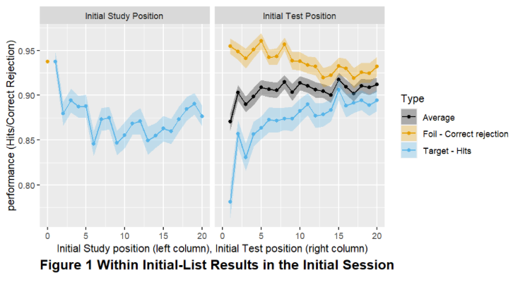
Within list results during Initial Testing:

Slide 15
Within list results during Initial Testing:
There is some primacy and a small
amount of recency when
we analyze by study position.
There is no evidence for output interference (OI) when we analyze by test position for the 10 target tests and ten foil tests for our pictures. Previous research found strong OI for words and for many more tests than ten. Our new REM model might explain this if it includes a first stage filter that only activates sufficiently strong traces (see comment below), and context changes during testing.
Overall there are higher correct responses to foils (‘correct rejections’ or CRs) than to targets (‘hits’ or Hs). However the difference decreases as testing continues. Our current best model to explain these results stores traces judged new during testing and strengthens traces judged old. It also has a first stage filter that only activates traces similar to both context and content in the probe of memory. This selectively activates traces more similar to the probe than would occur without testing effects.

Slide 16
To elaborate: We must add storage of information in memory during periods of recognition testing. Tests judged NEW cause storage of a new trace. Tests judged OLD are sometimes (perhaps most times) accompanied by trace recall. That recalled trace is strengthened by adding information from the test item.
According to REM 1997, strengthening a trace reduces its similarity to any different test item tested later. This shift increases the odds for a foil or different target tested later, increasing correct rejections and decreasing hits.
To ‘fix’ these predictions we add a filter that will prevent activation of traces that match the probe too poorly on the basis of both context features and content features. This filter will tend not to activate strengthened traces because they become less similar. Removing these traces increases the odds, lowers correct rejections and increases hits, and will do so more and more as testing continues, producing the results shown.

Slide 17
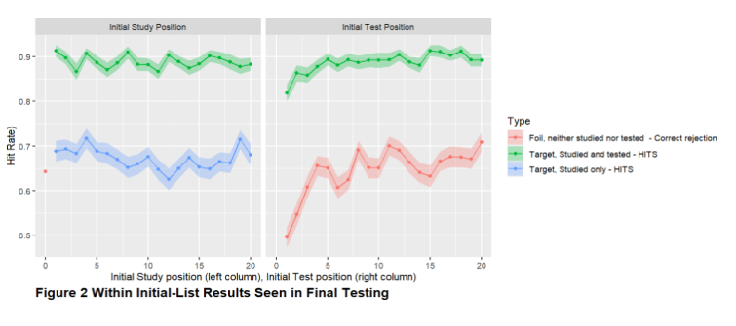
Final test results by study and test position within list initially.
1)Initial study position matters little in final testing.
2) The later an item is tested initially, after each list, the better it is recognized in final testing.
One possibility: Targets tested later might have an increased probability of ‘recalling’ its trace, due perhaps to associations with pictures recalled earlier in testing.

Slide 18
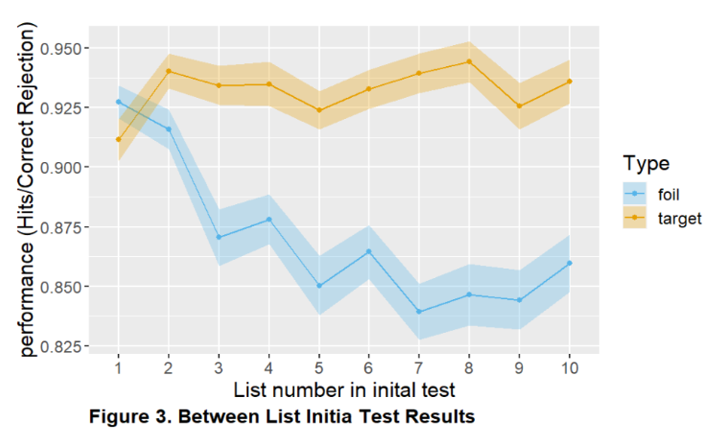
Final Test Results by Initial List Position:
REM generally predicts correct rejections to be higher than hits, on average.
The decrease in both hits and
performance as lists continue
could be due to activation of
traces from prior lists. Why
this is seen for hits only
depends on the details of how
REM is extended.

Slide 19
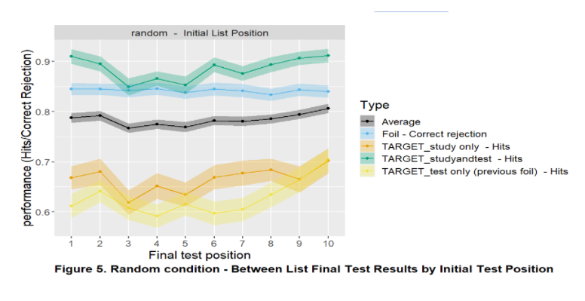
Final test performance as a function of initial list position (1-10) is best seen in the
random order testing condition. There is some modest primacy and recency.
Most striking, pictures studied only and foils tested only are similar and exhibit poor
performance, suggesting each have produced a similar strength trace, one during study and the other
during testing. The much better performance for items both studied and tested is likely due to trace
storage and strengthening during testing.

Slide 20
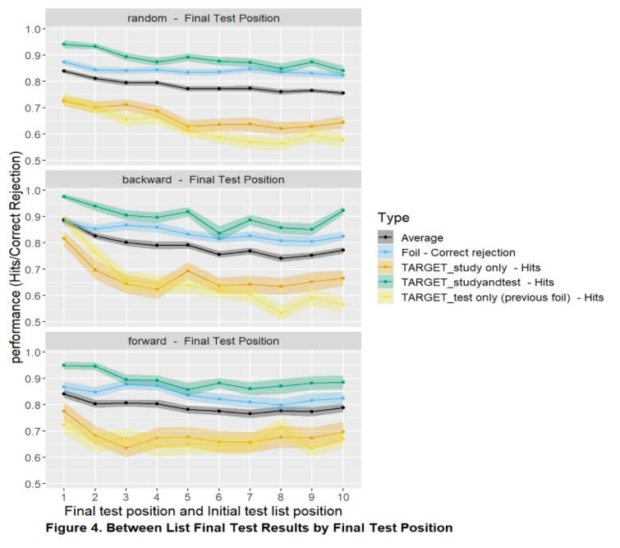
Analysis by final testing position shows
output interference (OI), as expected.
There appear to be some differences in
the amount of OI between random,
forward, and backward conditions,
and if so that might suggest different
context cues used in these conditions.
However, the existence of such effects
needs to be established with careful
modeling.

Slide 21
Thank you.

